Slide 1
Technical Audit of
Heart Disease ADS
Guilherme Albertini & Martin Keenan

Slide 2
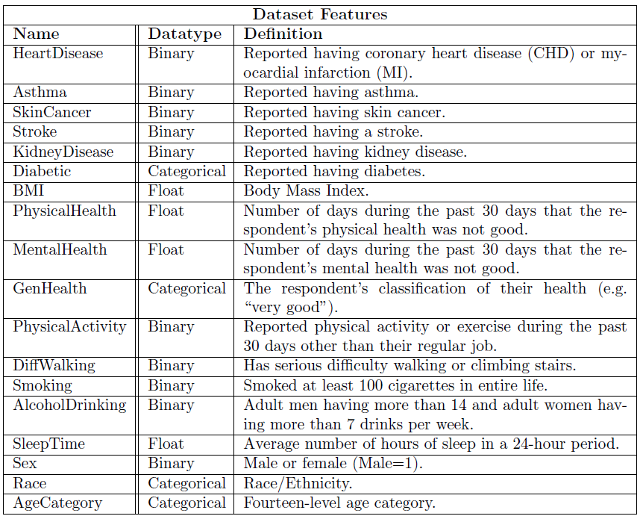
ADS
Model
Trained by Kaggle user Wessam Salah Walid
Predicts heart disease from patient features
Dataset
Source: CDC Behavioral Risk Factor Surveillance System
Target: Heart Disease
Sensitive Features: Sex, Race
400k observations

Slide 3
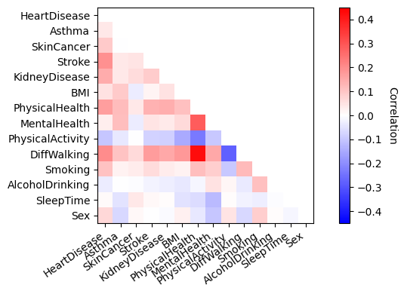
Feature Correlations
Heart disease is slightly correlated with Sex
It’s more highly correlated with other health indicators like Stroke and Difficulty Walking

Slide 4
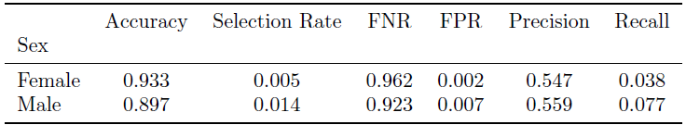
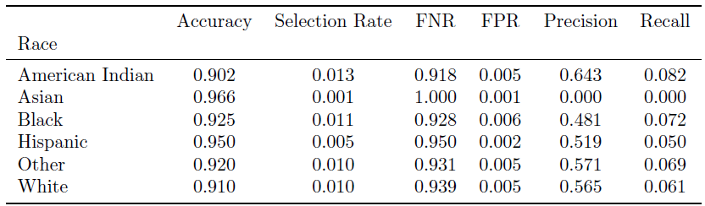
Metrics by Sex and by Race
Given the medical context, it is important to have a low and fair false negative rate

Slide 5
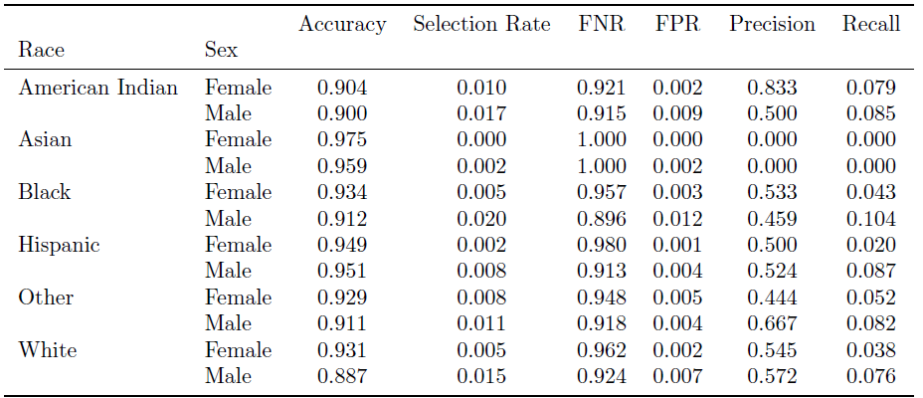
Metrics by Intersection of Sex and Race

Slide 6
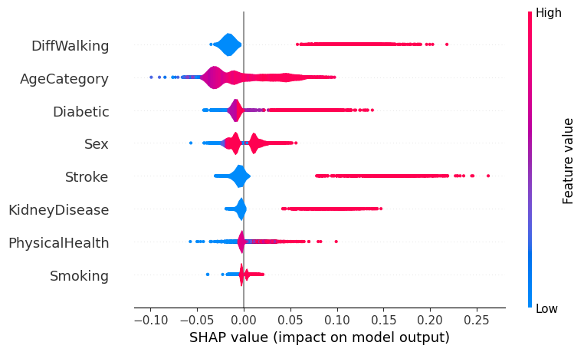
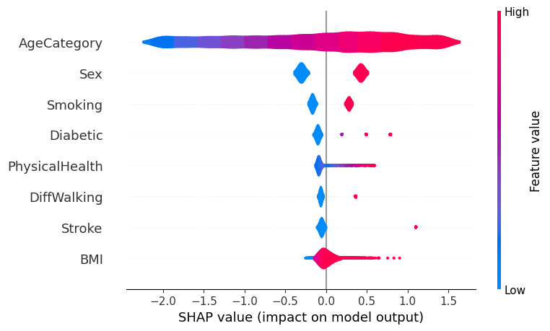
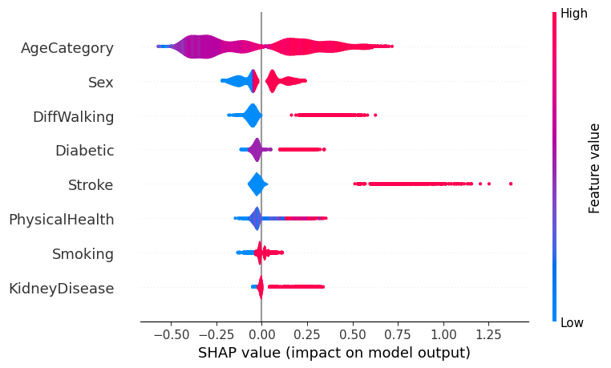
SHAP Values
Random Forest (top) and XGBoost (below)
Feature Importance
Most classifiers deemed AgeCategory, Sex, and DifficultyWalking as having the highest average impact on the predictions of Heart Disease across all instances
Longer bars indicate more influential features; thus, we see that AgeCategory is a key indicator of heart disease
Logistic Regression
Feature Value:
High - Heart Disease
Low - No Heart Disease

Slide 7
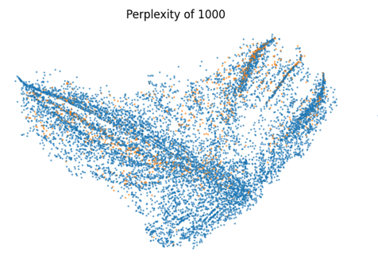

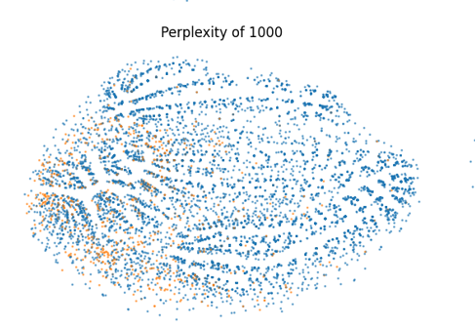
Encoding of Categorical Features
LabelEncoder
Author uses LabelEncoder for all categorical features, thereby imposing an integer ranking for all features consisting of “Yes/No” outputs and those with orderings without an inherent order, such as Race
For example, in encoding [White, Asian,White, Black, Asian] into [1,2,1,3,2] using LabelEncoder, the imposed integer rank may suggest that the average of White and Black is Asian to a classifier.
The fix: by enforcing the ordinal ranking only for GenHealth and AgeCategory and one-hot encoding the other (non-ranked) categorical features, we observe better data separability through t-SNE visualizations
OneHotEncoder and OrdinalEncoder

Slide 8
References
Wessam Salah Walid, “Heart Disease Prediction (EDA & Modelling)(Acc 95\%),” 2022, available at https://www.kaggle.com/code/wessamwalid/heart-disease-prediction-eda-modelling-acc-95.
Koshiyama, Adriano and Kazim, Emre and Treleaven, Philip and Rai, Pete and Szpruch, Lukasz and Pavey, Giles and Ahamat, Ghazi and Leutner, Franziska and Goebel, Randy and Knight, Andrew and others, “Towards algorithm auditing: a survey on managing legal, ethical and technological risks of AI, ML and associated algorithms,'' 2021.
CDC Behavioral Risk Factor Surveillance System, “Personal Key Indicators of Heart Disease,'' 2020, available at https://www.kaggle.com/datasets/kamilpytlak/personal-key-indicators-of-heart-disease?datasetId=1936563&sortBy=voteCount.

